Slide 1
CMSC201 Computer Science I for Majors Lecture 25 – Final Exam Review
Prof. Katherine Gibson
Prof. Jeremy Dixon

Slide 2
Office Hours
Tuesday is the last day office hours will be held

Slide 3
Exam Rules
The final is closed everything:
No books
No notes
No cheat sheets
No laptops
No calculators
No phones

Slide 4
Exam Rules
Place your bookbag under your desk/chair
NOT on the seat next to you
You may have on your desk:
Pens, pencils, erasers
Water bottle
UMBC ID
You must bring your UMBC ID with you to the exam! We won’t accept your test without it.

Slide 5
Exam Rules
DO NOT CHEAT!!!
Cheating will be dealt with severely and immediately
If a TA or instructor sees you looking at another student’s paper (or anything other than your own exam) they will take your test from you
Your TA or instructor may ask you to move at any time during the test

Slide 6
Exam Time
Final Exam will held be on Friday, May 13th from 6 PM to 8 PM
If you need SDS accommodations, you must request them and notify us ASAP

Slide 7
Exam Locations
Being held in three separate rooms
ENGR 027 – Sections 2, 5, 11, 12, 15, 22, and 23
Alex, Grace, Joe, Rishi, Ted, Tyler
ITE 102 – Sections 4, 14, and 21
Chris, Jeremy, Michael
ITE 104 – Sections 3, 9, 10, 16, 18, and 20
Hailee, Jacob, Katie, Liz, Patrick
Make sure you go to the correct room!

Slide 8
Exam Seating
Space allowing, you will sit every other seat, so that you are not next to another student
Your instructor may have specific instructions for their lecture hall seating arrangements
Make sure you know how to get to your exam room location – arrive early if possible!

Slide 9
Questions about Exam Rules?

Slide 10
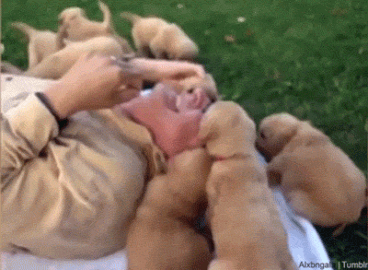

Slide 11
Exam Format
Similar to the midterm
Going over the slides and making sure you are comfortable with the material would be a good idea
Try some of the exercises and practice examples available in the slides

Slide 12
Exam Format
Multiple Choice
True/False
Code evaluation
Given code, what does it do?
Debugging
Find and fix errors
Fill in the blank
Complete a piece of partially-written code

Slide 13
Questions about Exam Format?

Slide 14
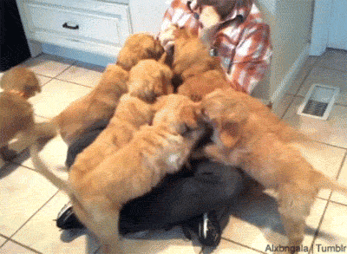

Slide 15
Exam Content
Everything we covered at the beginning!
From the midterm, you should be familiar with:
Evaluating expressions
Control structures
For Loops
While Loops (including Interactive loops)
If/Elif/Else
Decimal <-> Binary conversion

Slide 16
Exam Content
From the midterm, you should be familiar with:
Lists
Indexing (including negative indexing)
Appending
Debugging
Strings
String functions like split()

Slide 17
Exam Content
Everything else we’ve covered so far!
You should be especially familiar with:
More control structures
Recursion
Functions
Passing and returning variables
File I/O

Slide 18
Exam Content
You should be especially familiar with:
Data structures
Tuples
Dictionaries
Classes
Creating a class
Data vs class attributes
Constructors
Built-in methods

Slide 19
Exam Content
You should be especially familiar with:
Algorithms and Analysis
Searching algorithms
Linear
Binary
Sorting algorithms
Selection
Bubble
Quick
You should understand how they work, and know how fast they run.

Slide 20
Exam Content
You should be especially familiar with:
Recursion
Recursion
Recursion
Program design
Top down design
Creating “good” code

Slide 21
Questions about Exam Content?

Slide 22
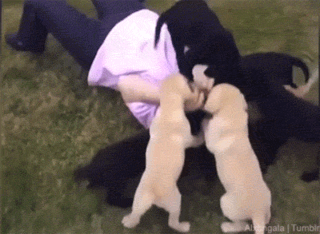

Slide 23
Exam Advice
Write down your name and circle your section
Flip through the exam and get a feel for the length of it and the types of questions

Slide 24
Exam Advice
Some questions have partial credit
You should at least attempt every problem
If you don’t know how to do one part of the problem, skip it and do the rest
Make sure to pace yourself – this exam is longer than the midterm!

Slide 25
Exam Advice
If a problem is unclear or you think there is an error on the exam, raise your hand

Slide 26
Any Other Questions?

Slide 27
